Slide 1
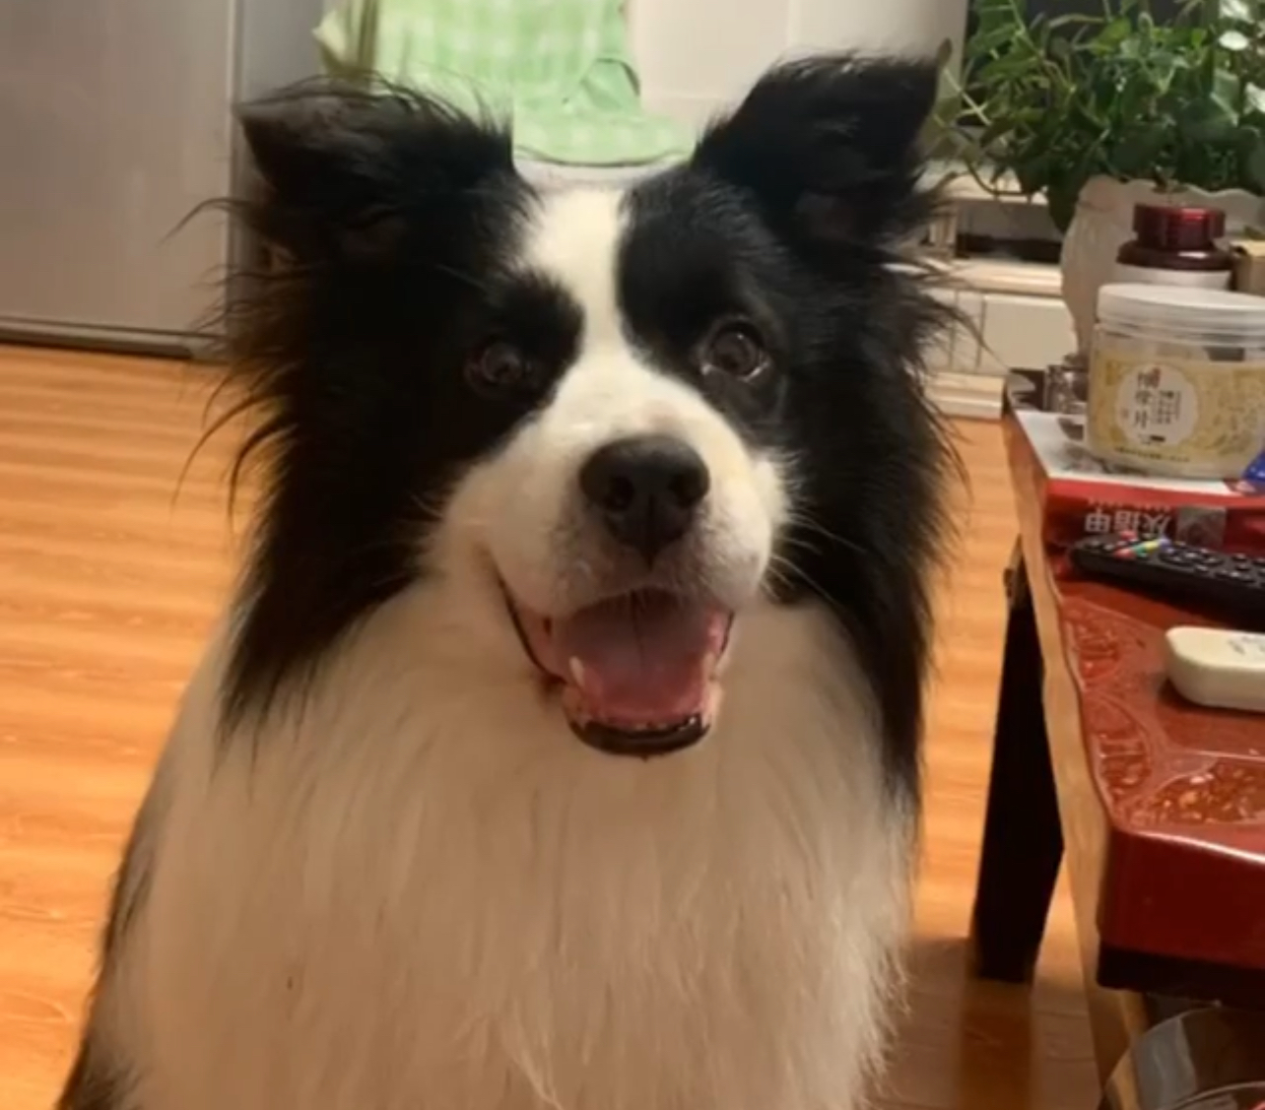

Campaign Performance Analysis
Insights and Recommendations for Spot Pet Insurance

Slide 2
TABLE OF CONTENTS
01
02
03
04
Introduction
Top Campaigns by Profit Margin
Overview, Key Objectives, and KPIs
Performance Assessment, Insights, and Recommendations
Top Campaigns by Total Profit
Appendix
Performance Assessment, Insights, and Recommendations
SQL codes and data tables

Slide 3
Introduction
Goal: To understand how top campaigns have contributed to our overall business objectives, identify areas of strength, and highlight opportunities for improvement.
Primary objective: To evaluate the effectiveness of our marketing campaigns by examining KPIs, including Number of Purchases, Profit Margin, Total Profits, and ROI.

Slide 4
Key Performance Indicators
Number of Purchases | The total count of transactions where customers buy a Spot’s insurance plan.
Total Revenue | The sum of all income generated from sales of Spot’s pet insurance plans over three and half months.
Profit Margin | The percentage of revenue that the Spot gets to keep after deducting costs, showing how much profit Spot makes for every dollar of revenue.
Total Profit | Measures the overall profit generated by a campaign by subtracting the total cost from the total revenue.
ROI | Assesses the efficiency of a campaign by comparing the net profit to the total cost, expressed as a percentage.

Slide 5
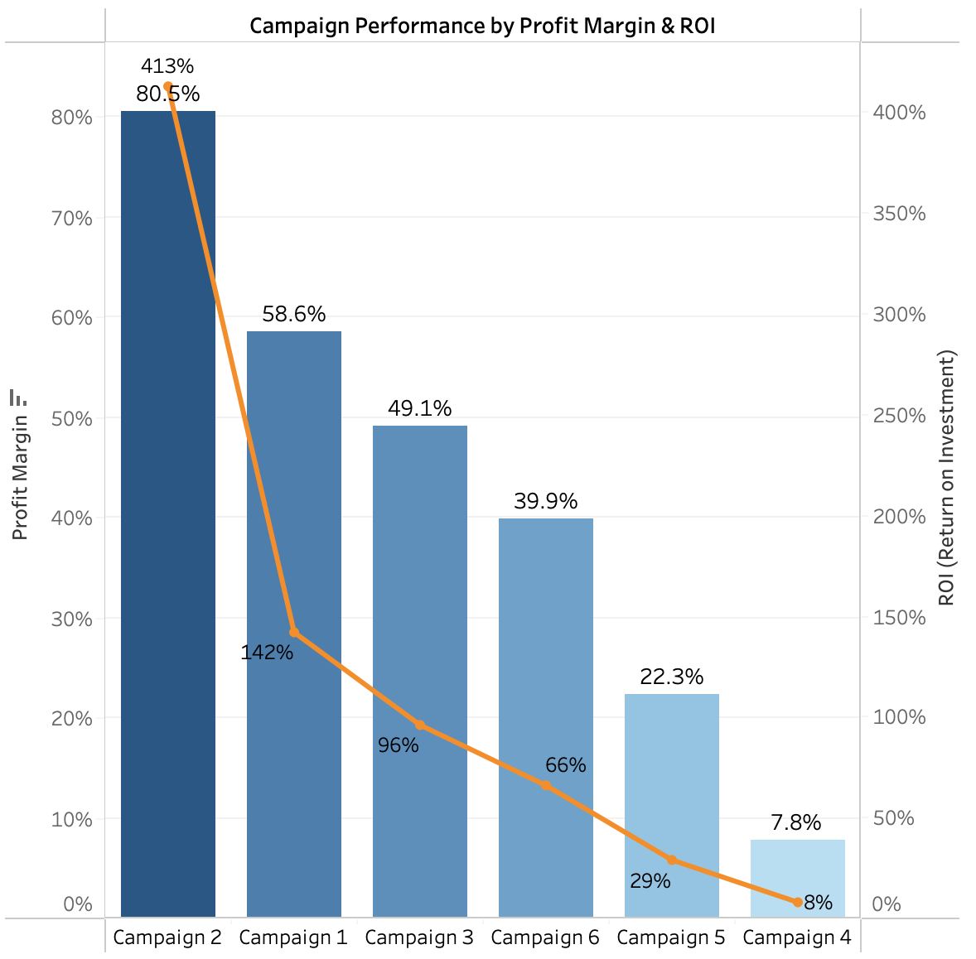
Top Campaigns by Profit Margin
If the company's objective is to invest in campaigns that returns the highest profit margin and ROI:
Campaign 2 (Youtube Videos): Leads with the highest profit margin of 80.5% and a ROI of 413%.
Campaign 1 (AI-Driven Multi-Medium Ads): Follows as the second strongest with a profit margin of 58.6% and a ROI of 142%.

Slide 6
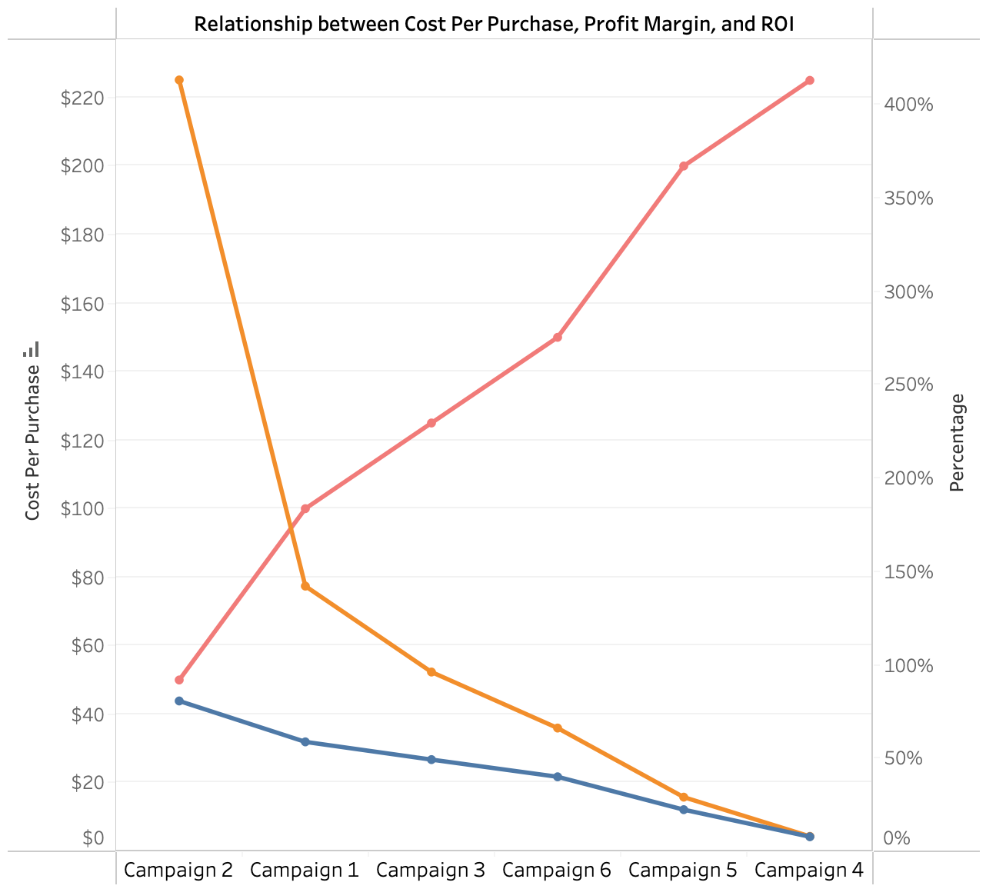
Key Insight #1
Cost-Efficiency of Leading Campaigns
Our top-performing campaigns, YouTube Videos and AI-Driven Multi-Medium Ads, achieve the lowest cost per purchase, resulting in higher profit margins and ROI.
What does it mean for Spot Pet Insurance?
Having high profit margins and ROI from Campaign 2(Youtube Videos) and Campaign 1 (AI-Driven Multi-Medium Ads) means we can effectively convert marketing expenditures into substantial profits.
Cost Per Purchase
$100
$50
ROI
Profit Margin

Slide 7
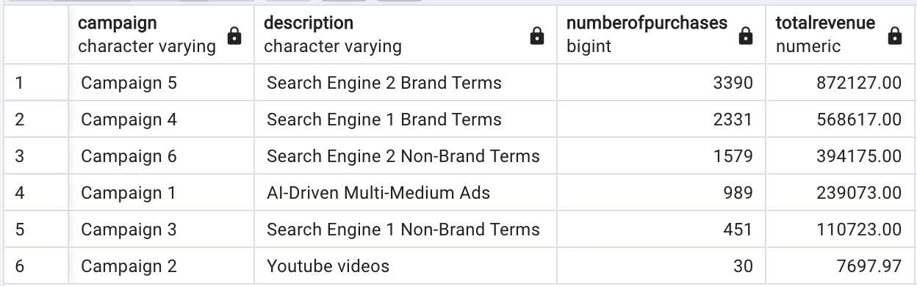
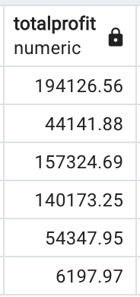
Key Insight #2
Top Campaigns Show Lower Customer Acquisition Numbers
Although Campaigns 2 and 1 achieved the highest profit margins and ROI, they acquired the fewest number of customers.
Hypothesis: Possibly due to low customer conversion rate due to low intent customers receiving Youtube Videos and AI-Driven Multi-Medium Ads?
What does it mean for Spot Pet Insurance?
Low customer acquisition numbers can lead to lower total revenue and total profits overall, which explains why Campaigns 1 and 2 have lower total profits.

Slide 8
Recommendations
01
02
03
Prioritize Investment
If the company faces budget constraints, prioritize Campaigns 1 and 2 due to their strong profit margins and ROI.
Maintain High Profit Margins and ROI of Campaigns 1 and 2
Enhance Customer Acquisition
Optimizing advertising algorithms to improve customer conversion rate. This will increase total profits and leverage high ROI campaigns.
Continuing Effective Strategies: Keep using the advertising content that has led to high profitability and efficient returns.

Slide 9
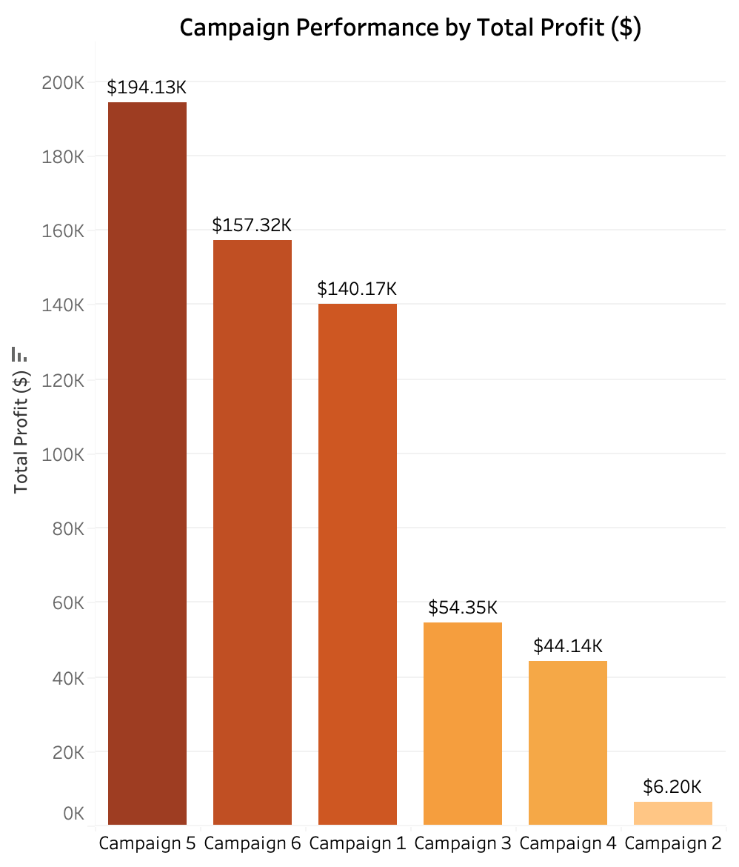
Top Campaigns by Total Profit
If the company's objective is generating the most total profits from selling pet insurance plans:
Campaign 5 (Search Engine 2 Brand Terms): Leads with the highest Total Profit of $194,126.56
Campaign 6 (Search Engine 2 Non-Brand Terms): Follows as the second strongest with Total Profit of $157,324.69

Slide 10
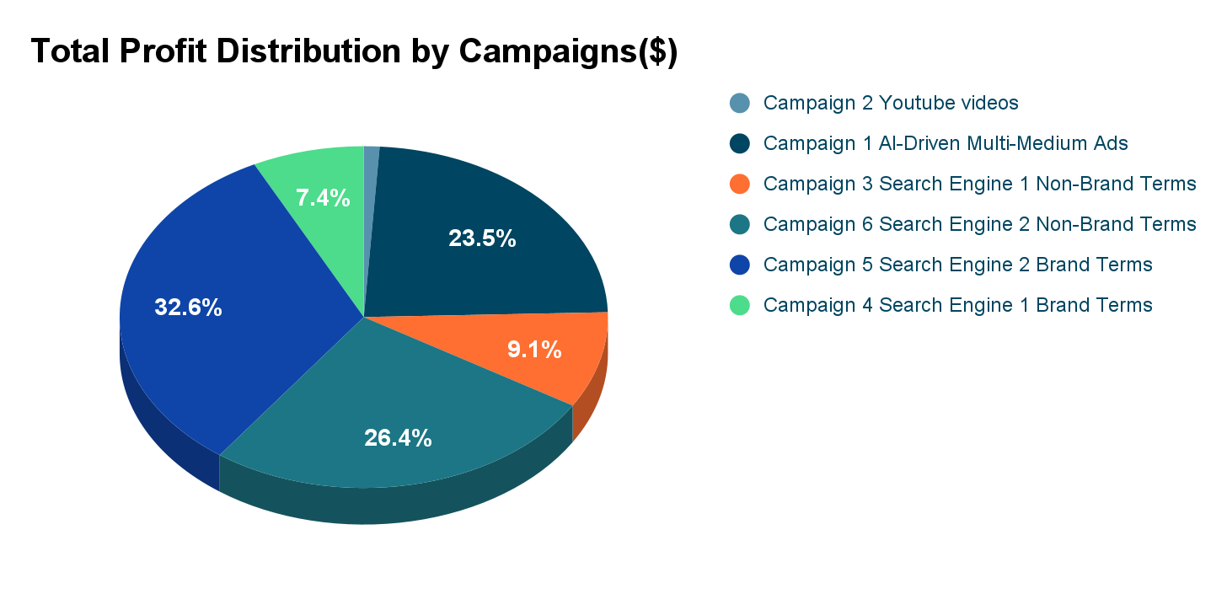
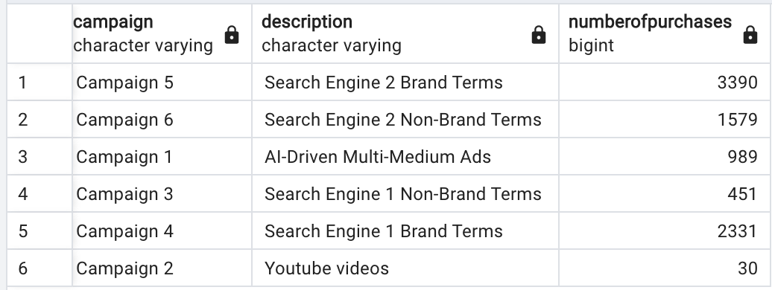
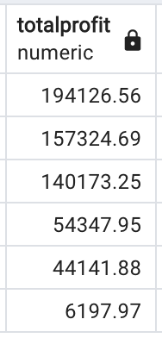
Key Insight
Search Engine 2 is a Strong Channel
Both campaign 5 and 6 demonstrate that search engine 2 marketing, whether targeting brand or non-brand terms, is a strong channel for driving total profit.
1%
Campaign 5 and 6 generated 59 % of total profits of all campaigns

Slide 11
Recommendations
Maintain Campaign 5 & 6
Increase Campaign Duration
Continue running campaigns on Search Engine 2 because these campaigns generate high total profits.
Extending the duration of campaigns 5 & 6 (long-term marketing) will allow for sustained profit generation, provided that it aligns with Spot’s budget.

Slide 12

Thank you!
Appendix
SQL Codes and Data tables

Slide 13
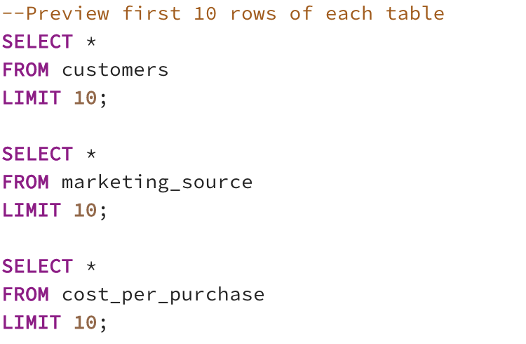
SQL Code

Slide 14
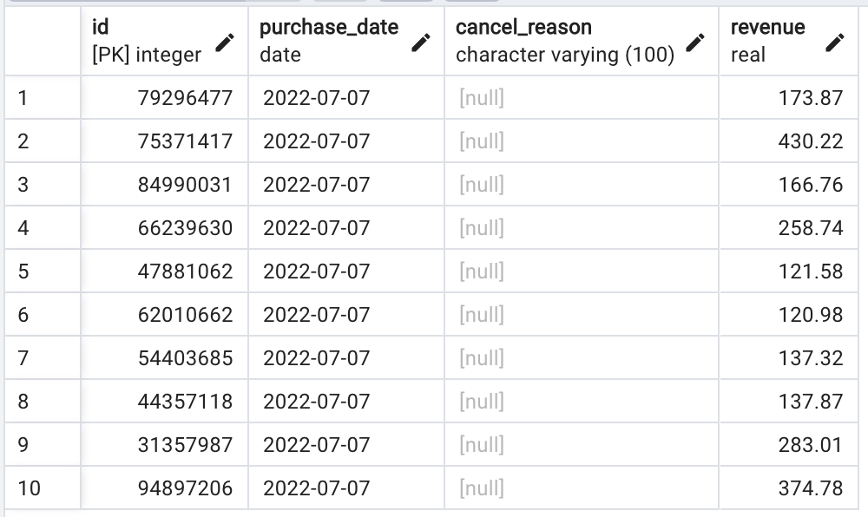
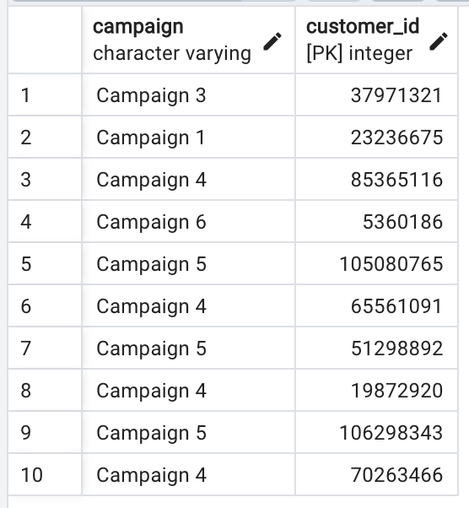
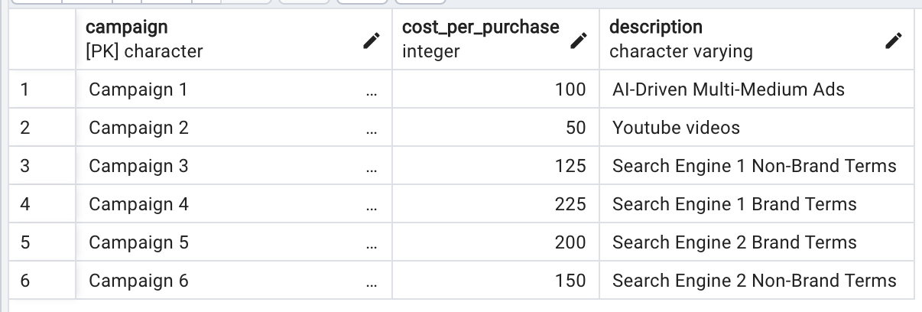
Output

Slide 15
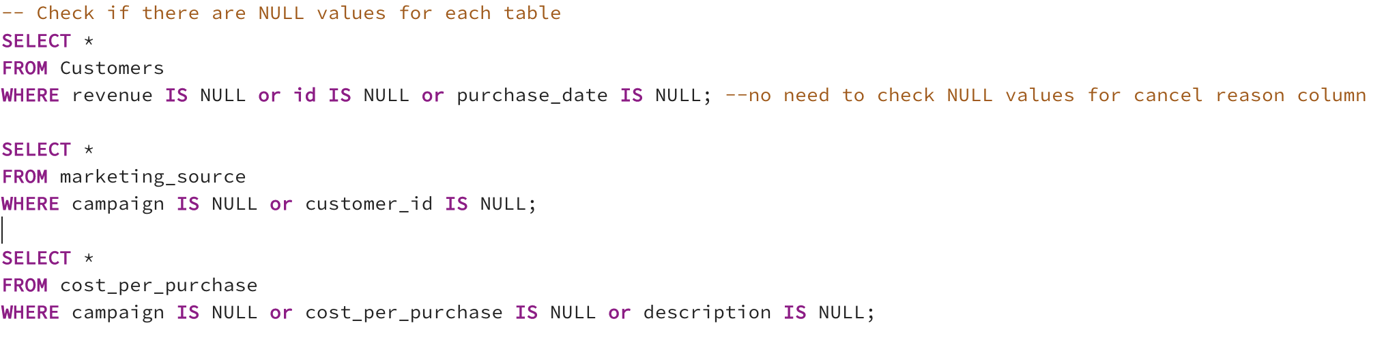
SQL Code

Slide 16
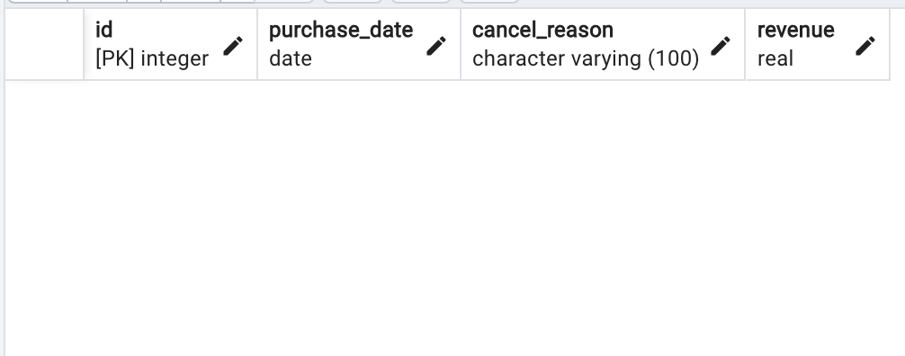
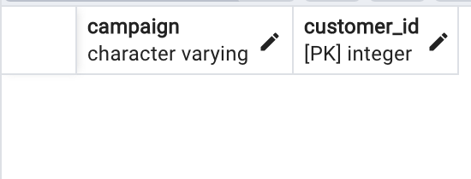
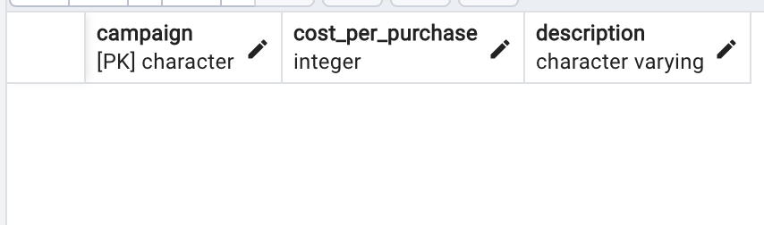
Output

Slide 17
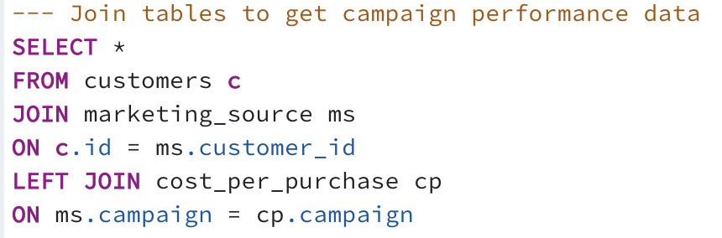
SQL Code

Slide 18
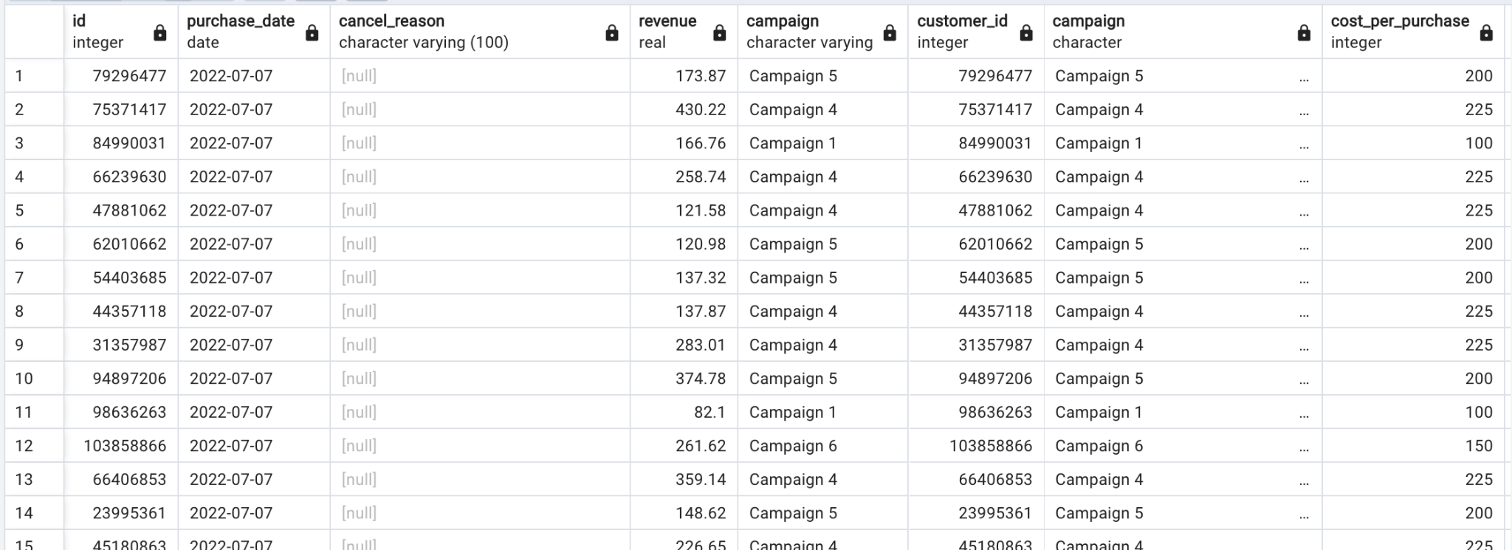
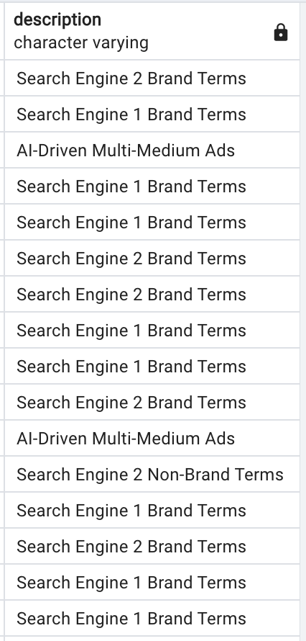
Output

Slide 19
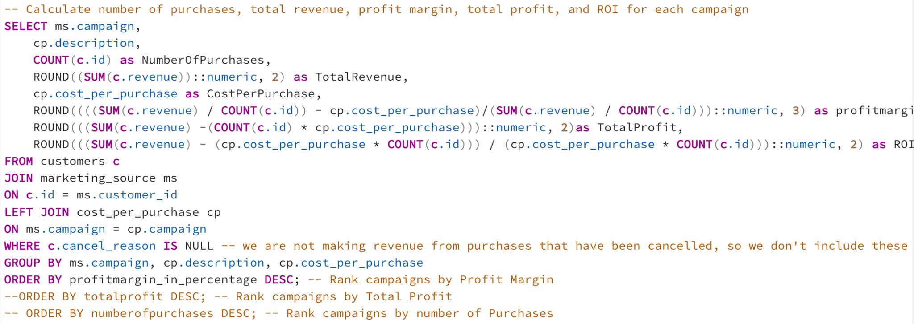
SQL Code

Slide 20
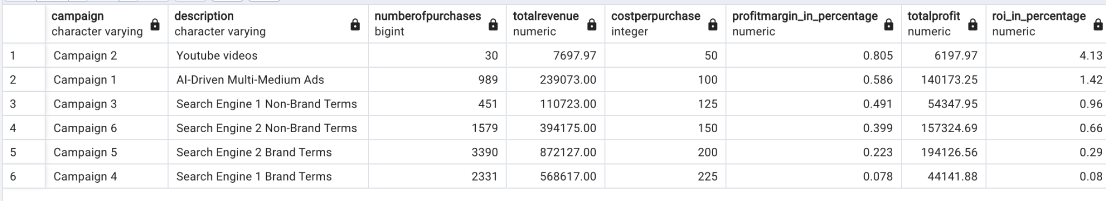
Output

